Slide 1
The Evolution of Stream Processing Systems
Faria Kalim
Notes:
https://www.youtube.com/watch?v=MOdpjfhxRZU
https://15445.courses.cs.cmu.edu/fall2018/slides/25-voltdb.pdf

Slide 2
Defining Stream Processing Apps
“There is a large class of emerging applications in which data, generated in some external environment, is pushed asynchronously to servers that process this information.
Some example applications include sensor networks, location-tracking services, fabrication line management, and network management.
These applications are characterized by the need to process high-volume data streams in a timely and responsive fashion. Hereafter, we refer to such applications as stream-based applications.”
Scalable Distributed Stream Processing , CIDR 2003

Slide 3
Requirements of Stream Processing
Requirements
Keep the Data Moving
SQL on Streams
Handle Stream Imperfections
Predictable Outcome
High Availability
Stored & Streamed Data
Distribution & Scalability
Instantaneous Response
The 8 Requirements of Real-Time Stream Processing, SIGMOD 2005

Slide 4
Solutions
Requirements | Data Warehouse Solutions (Databases) | Complex Event Processing Systems (CEPs/SPEs)
Keep the Data Moving | No | Yes
SQL on Streams | No | Yes
Handle Stream Imperfections | Difficult | Possible
Predictable Outcome | Difficult | Possible
High Availability | Possible | Possible
Stored & Streamed Data | No | Yes
Distribution & Scalability | Possible | Possible
Instantaneous Response | Possible | Possible
The 8 Requirements of Real-Time Stream Processing, SIGMOD 2005

Slide 5
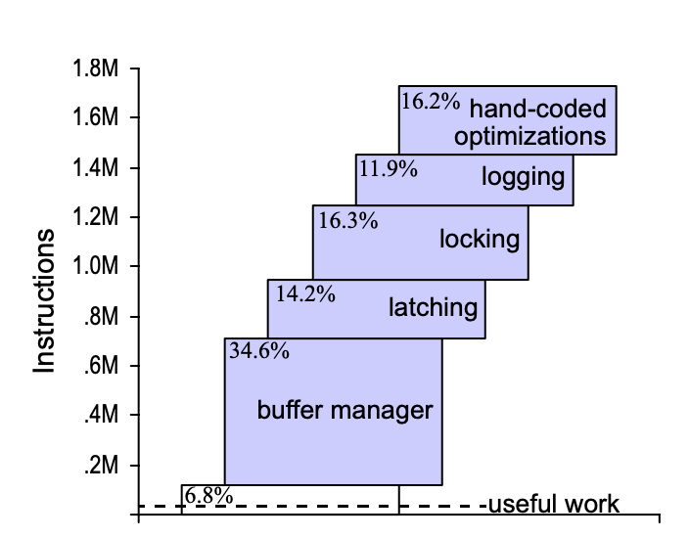
DBMS Solutions: Background
Running TPC-C over Shore
OLTP Through the Looking Glass, and What We Found There, SIGMOD 2008

Slide 6
DBMS Solutions
H-Store →
In-memory relational database
Single threaded engines running in parallel
Partitioned to the core (thus, concurrent)
No external transaction control
Durability through replication
Serializable (two phase commit)
The End of an Architectural Era (It’s Time for a Complete Rewrite), VLDB 2007

Slide 7
DBMS Solutions
H-Store → S-Store (features added to VoltDB)
Transaction
Data
Any topological ordering of transactions
emulates DAG
Transaction
S-Store: Streaming Meets Transaction Processing, VLDB 2015

Slide 8
S-Store Architecture
S-Store: Streaming Meets Transaction Processing, VLDB 2015

Slide 9
DBMS Solutions
H-Store → S-Store (features added to VoltDB)
Streaming features
Windows (finite chunks of data over unbounded streams)
Triggers (computations to be carried out for newly generated data)
Workflow (computation pipeline of related transactions)
S-Store: Streaming Meets Transaction Processing, VLDB 2015

Slide 10
DBMS Solutions
H-Store → S-Store (features added to VoltDB)
System | ACID | Order | Exactly Once | Max Throughput
Storm + VoltDb | Y | Y | Y | 600
S-Store | Y | Y | Y | 2200
S-Store: Streaming Meets Transaction Processing, VLDB 2015

Slide 11
Stream Processing Systems (Complex Event Processing Systems)
1. Keep the data moving
8. Instantaneous Response
Complex Computation
e.g. ML
Data

Slide 12
Stream Processing Systems
Queues
Data
Apache Storm (https://www.youtube.com/watch?v=bdps8tE0gYo), 2012

Slide 13
Stream Processing Systems
Data
Task Parallelism
Apache Storm (https://www.youtube.com/watch?v=bdps8tE0gYo), 2012

Slide 14
Differential Dataflow
Iterative, interactive applications
e.g. graph processing
Differential Dataflow, CIDR 2013

Slide 15
Differential Dataflow
Incremental Computation
Differential Dataflow, CIDR 2013

Slide 16
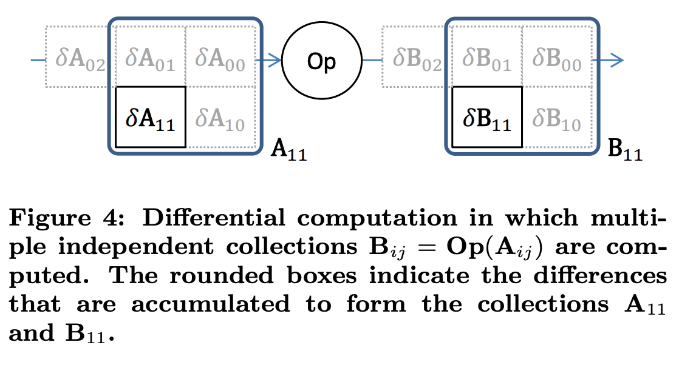
Differential Dataflow
8. Instantaneous Response
Partial Orders
Tradeoffs:
- Memory for performance
- Operators
Related Work
- Noria
- Tegra
Differential Dataflow, CIDR 2013

Slide 17
Google Dataflow
3. Handle Stream Imperfections
4. Predictable Outcomes
6. Stored & Streamed Data
The Dataflow Model, VLDB 2015

Slide 18
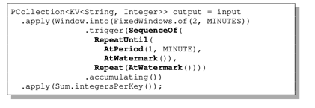
Dataflow
Pcollections can be used for batch and streaming data
The Dataflow Model, VLDB 2015

Slide 19
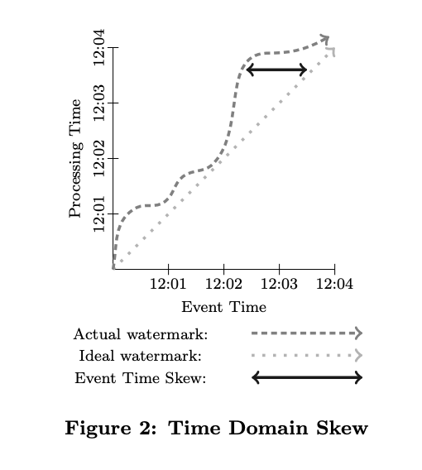
Dataflow
The Dataflow Model, VLDB 2015

Slide 20
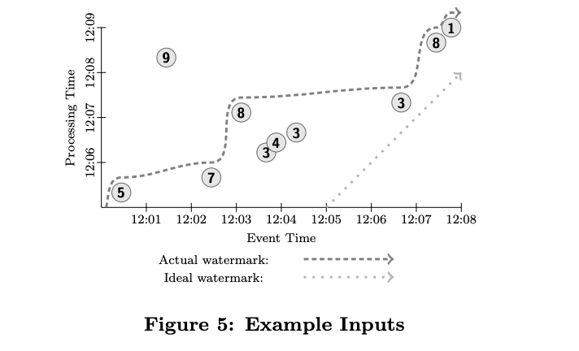
Dataflow
The Dataflow Model, VLDB 2015

Slide 21
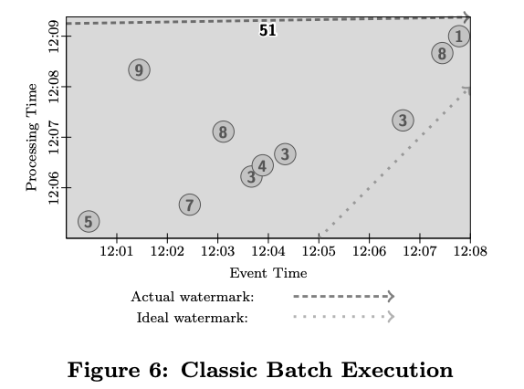
Dataflow
The Dataflow Model, VLDB 2015

Slide 22
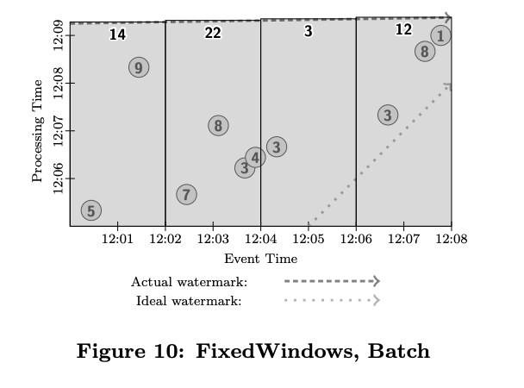
Dataflow
The Dataflow Model, VLDB 2015

Slide 23
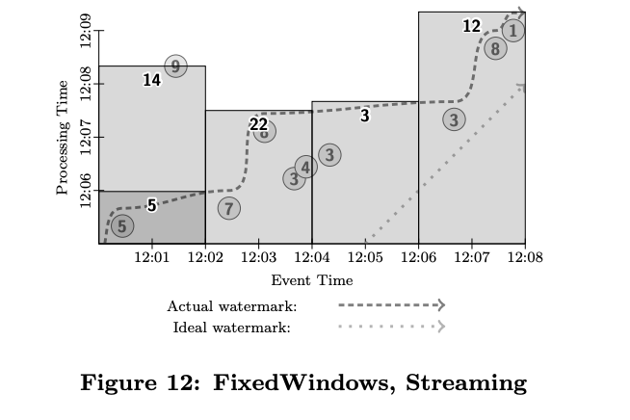
Dataflow
Triggers as earlier
The Dataflow Model, VLDB 2015
Notes:
Triggers only at watermark

Slide 24
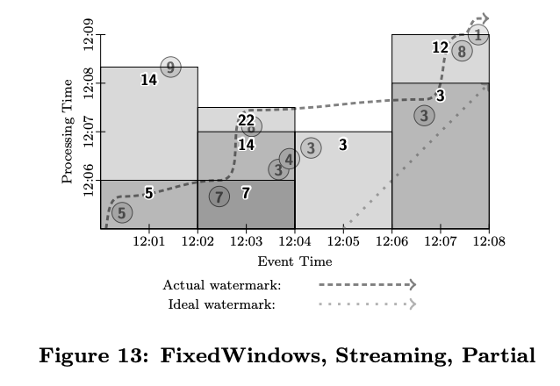
Dataflow
Improve result latency
The Dataflow Model, VLDB 2015

Slide 25
Kafka
5. High Availability
Topic Based Publish Subscribe System
https://kafka.apache.org/

Slide 26
Kafka Cluster

Slide 27
Kafka

Slide 28
Kafka Streams

Slide 29
Problems
Apache Pulsar
Stateless Brokers
Apache Bookkeeper for State

Slide 30
SQL on Streams
Challenges:
Pervasive use of time-varying relations
Robust event-time semantics support
Materialization control
One SQL to rule them all, arXiv 2019
Continuous Query Language, VLDB 2015
Apache Calcite

Slide 31
Requirements of Stream Processing
Requirements
Keep the Data Moving
SQL on Streams
Handle Stream Imperfections
Predictable Outcome
High Availability
Stored & Streamed Data
Distribution & Scalability
Instantaneous Response
Active Areas
The 8 Requirements of Real-Time Stream Processing, SIGMOD 2005

